Slide 1





Predictive Analytics
Grand Challenges
Mykola Pechenizkiy
http://www.win.tue.nl/~mpechen/
AI Ukraine 2015, Kharkiv, Ukraine
12 September 2015

Slide 2

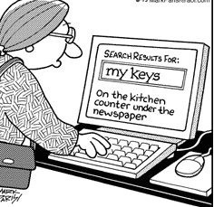
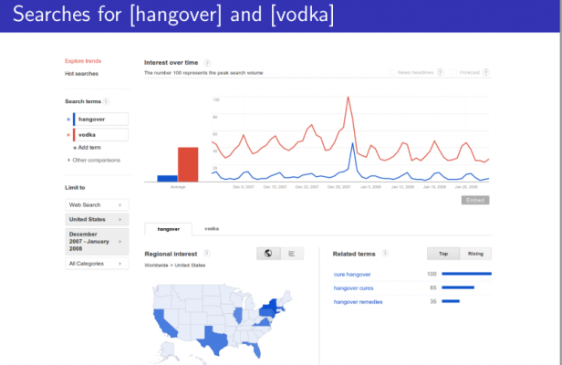
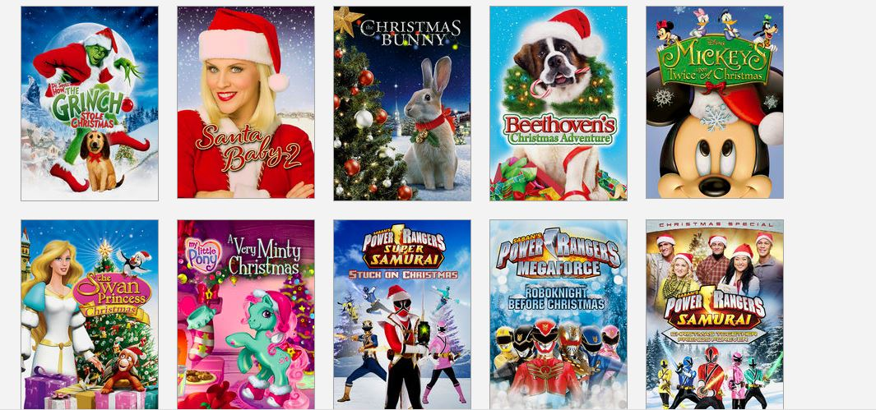
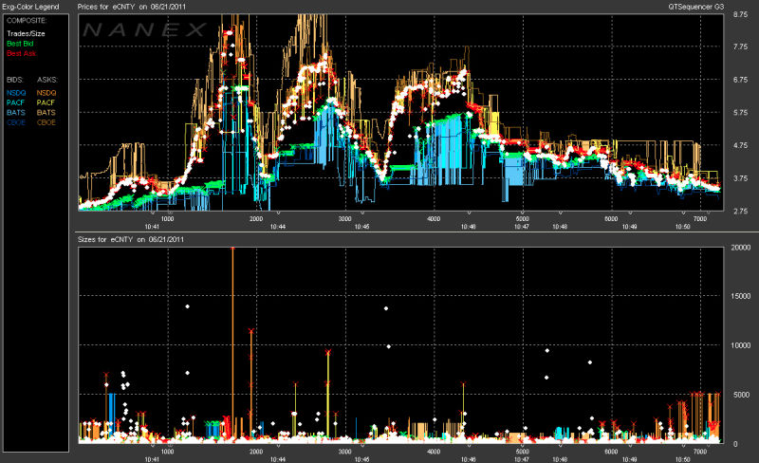
Predictive Modeling Tasks

Slide 3
Outline
Big data and predictive analytics
  Scale, speed, adaptivity
Evolving data: known vs. hidden contexts
  Concept drift handling & context-awareness
Ethics-awareness in predictive analytics
  Trust, fairness, accountability, & transparency
  Outlook and take home messages
  Anecdots: foodsales, stress analytics, VoD

Slide 4
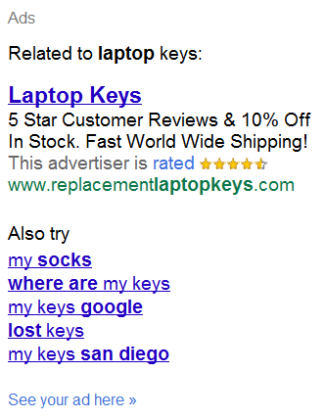
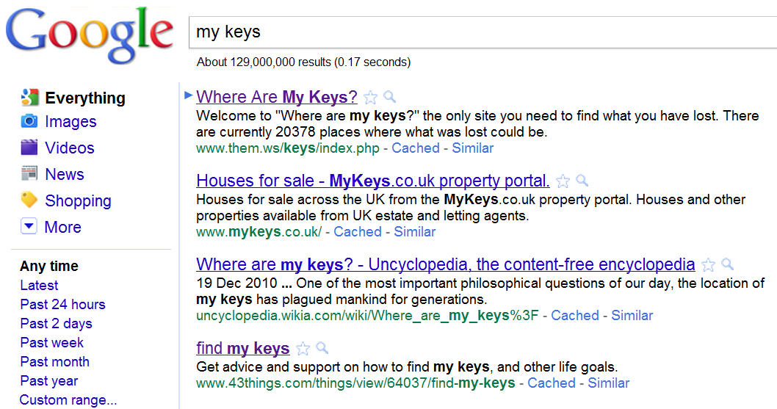
Don’t Hesitate Asking

Slide 5
Massive Automation of Decision Making
Google search (40k queries/second)
Google AdWords (40k auctions/second)
High Frequency Stock Trading (ms)
Facebook's news feed
RecSys by Booking.com, Airbnb, Amazon, Netflix, OKCupid date matching, …
Food for thought:
  What the predictive analytics behind these services is really optimizing for?
  What could be made public about how the algorithms work?
Notes:
“A new digital ecology is evolving, and humans are being left behind”

Slide 6
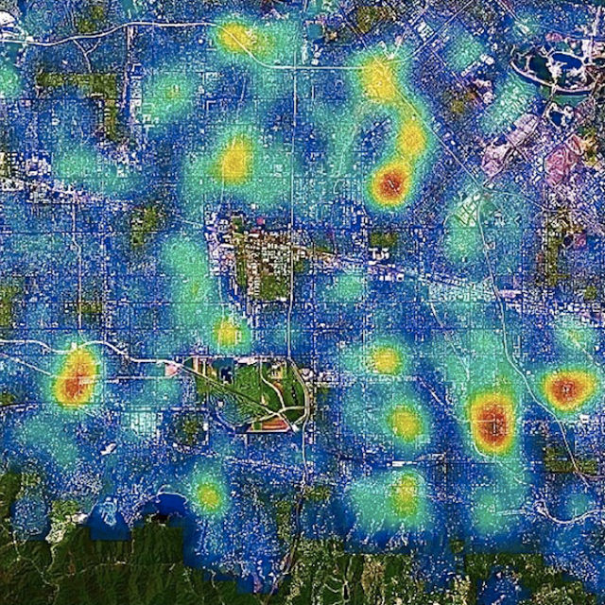
“Helping” Domain Experts
Police – screening suspects in airports
Judges – deciding on pre-trial period of suspects
eCommerce – cookie-based price adjustments
Education – giving a negative study advice
Mortgages, car insurances, jobs, salaries, …
Food for thought:
Discrimination – inferior treatment based on ascribed group rather than individual merits
Predictive analytics as means of gaining insights
into human evaluations
Notes:
How are they wrong, how are the biased
(Personalized) Medicine

Slide 7
Part I: Massive Automation of Decision Making
Handling concept drift in predictive analytics

Slide 8
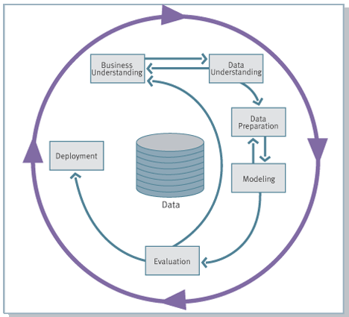
Predictive Analytics: CRISP-DM 1.0
Notes:
Skip if lack of time

Slide 9
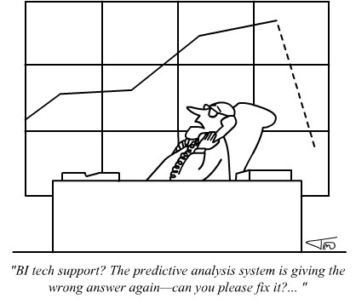
Predictive Analytics: CRISP-DM 1.0

Slide 10

Predictive Analytics: CRISP-DM 1.0
Notes:
Of it we make an example of developing predictive model for a driverless car, we would not like to call a data scientist every time the road conditions change. We want models to be capable of recognizing relevant contexts and adjusting their predictions accordingly.

Slide 11
Predictive Analytics: CRISP-DM 2.0
Evolving data
Performance monitoring
Model adaptation
Context-awareness
Handling concept drift
Notes:
Skip if lack of time

Slide 12
A Shortlist of Most Common Traps
Rhine paradox
Correlation vs. causality
Simpson paradox
Biased historical data
All forms of overfitting
Bonferroni’s principle
Data dredging, insignificant finding, multiple testing
GIGO: Garbage in – garbage out
Right problem formulation; optimizing for right KPIs
Concepts we model evolve over time

Slide 13
Supervised Learning under Concept Drift
population
= ??
Training:
y = L (X)
Application:
y' = L?? (X')
population
New
data
X'
Historical
data
Model L
X
y
labels
label?
y'

Slide 14
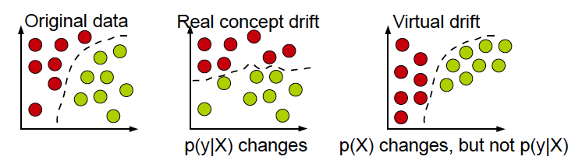

Real vs. Virtual Concept Drifts
circles represent instances (X),
different colors represent different classes (y)
concept drift between t₀ and t₁:
changes that affect the prediction decision require adaptation
Notes:
- the prior probabilities of classes p(y) may change,
- the class conditional probabilities p(Xjy) may change, and
- as a result, the posterior probabilities of classes p(yjX) may change affecting the prediction
the input data characteristics or the relation between the input data and the target variable may change
From a predictive perspective only the changes that affect the prediction
decision require adaptation
The real concept drift refers to changes in
the conditional distribution of the output (i.e., target variable) given the input (input
features), while the distribution of the input may stay unchanged. A typical example
of the real concept drift is a change in user’s interests when following an online news
stream. Whilst the distribution of the incoming news documents often remains the
same, the conditional distribution of the interesting (and thus not interesting) news documents for that user changes.
Originally a virtual drift has been defined [Widmer and Kubat 1993] to occur
due to incomplete data representation rather than change in concepts in reality,
— Virtual drift corresponds to change in data distribution that leads to changes in
the decision boundary [Tsymbal 2004],
— Virtual drift is a drift that does not affect the target concept [Delany et al. 2005],
— Virtual drift has been also referred to as temporary drift [Lazarescu et al.
2004],sampling shift [Salganicoff 1997] and feature change [Gao et al. 2007],

Slide 15
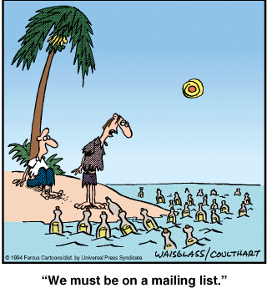
Identifying Worthy Content

Slide 16


Classify e-mails into “Spam” vs. “Inbox”
Inbox
Spam
Spam
? Contains:
“$1mln”, “Viagra”,
”prescription”, “renew”
...
Inbox
Spam
Inbox
no
yes
Inbox
Spam

Slide 17
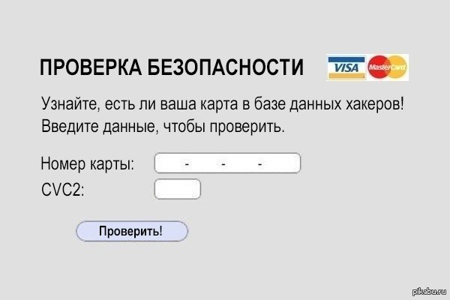
Adversary activities

Slide 18



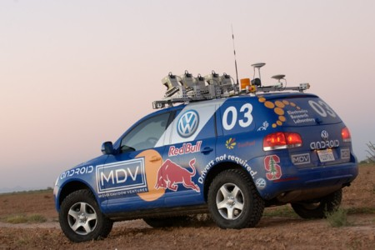
Predictive Analytics on Evolving Data
  Prediction systems need to be adaptive to changes over time to be up to date and useful
Changes in personal interests or in population
characteristics
(adaptive news access)
Adversary
activities
(avoiding
spam filters;
credit card
fraud)
  Changes in
  population
  characteristics
  (credit scoring)
Complexity of
the environment
  (driverless cars)
Notes:
Adaptive learning algorithms can be seen as advanced incremental learning
algorithms that are able to adapt to evolution of the data generating process over time.
Prediction systems operate over time
Changes in underlying patterns may happen
Changes may come from different sources
Adversary activities (card fraud)
Changes in population characteristics (credit scoring)
Changes in personal interests (news access)
Complexity of the environment (driverless cars)
Prediction systems need to be adaptive to changes over time to be up to date and useful

Slide 19
Adaptive Learning Strategies
Selecting the right training data
or adjusting
the model
?
L_{t+1}
Updated/ new model
More training data is no longer better
now
prediction

Slide 20
Techniques to Handle Concept Drift
Triggering
Evolving
change detection and a follow up reaction
adapting every step
Single classifier
Detectors
Forgetting
variable windows
fixed windows,
Instance weighting
Ensemble
Dynamic ensemble
Contextual
adaptive
fusion rules
dynamic integration,
meta learning

Slide 21
Techniques to Handle Concept Drift
reactive, forgetting
Triggering
Evolving
Single classifier
Detectors
Forgetting
variable windows
fixed windows,
Instance weighting
Ensemble
Dynamic ensemble
Contextual
maintain some memory
adaptive
fusion rules
dynamic integration,
meta learning

Slide 22
Closer Look
Triggering
Evolving
Forget old data and retrain at a fixed rate
Single classifier
Detectors
Forgetting
fixed windows,
Instance weighting
Ensemble
Dynamic ensemble
Contextual

Slide 23
Fixed Training Window
time

Slide 24
Closer Look
Triggering
Evolving
Detect a change and cut
Single classifier
Detectors
Forgetting
variable windows
Ensemble
Dynamic ensemble
Contextual

Slide 25
Variable Training Window

Slide 26
Change Detection
Where to look for a change?
input
output
model
performance
monitoring
techniques that handle the real CD can also handle CDs that manifest in the input, but not the other way around

Slide 27
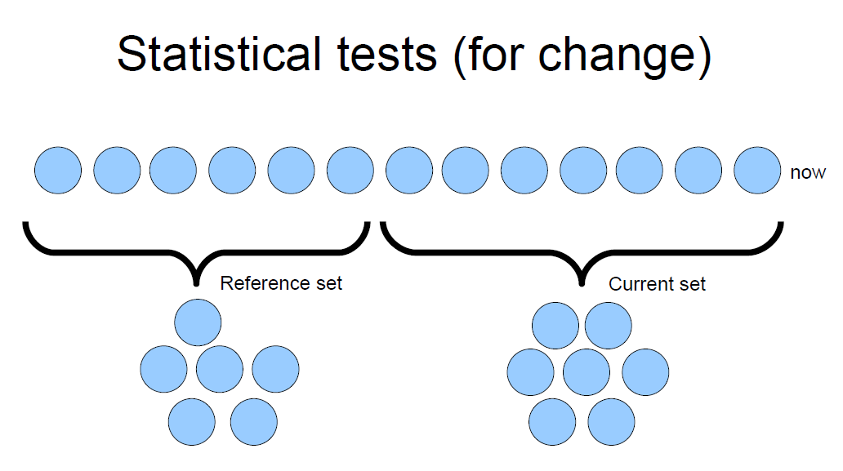
Detection
change point
new window
compare using
a statistical test

Slide 28
Closer Look
Triggering
Evolving
Single classifier
Detectors
Forgetting
Ensemble
Dynamic ensemble
Contextual
adaptive
fusion rules
build many models,
dynamically combine

Slide 29
Dynamic Ensemble
Classifier 1
Classifier 2
vote
Classifier 3
Classifier 4

Slide 30
Dynamic Ensemble
voter 1
time
voter 2
voter 3
voter 4
TRUE

Slide 31
Dynamic Ensemble
punish
voter 1
voter 1
reward
voter 2
voter 2
punish
voter 3
voter 3
reward
voter 4
voter 4
TRUE

Slide 32
Dynamic Ensemble
punish
voter 1
voter 1
reward
voter 2
voter 2
punish
voter 3
voter 3
reward
voter 4
voter 4
TRUE
TRUE

Slide 33
Dynamic Ensemble
punish
voter 1
voter 1
voter 1
reward
voter 2
voter 2
voter 2
punish
voter 3
voter 3
voter 3
reward
voter 4
voter 4
voter 4
TRUE
TRUE

Slide 34
Closer Look
Triggering
Evolving
Single classifier
Detectors
Forgetting
Ensemble
Dynamic ensemble
Contextual
dynamic integration,
meta learning
build many models,
switch models according to the observed incoming data

Slide 35
Dynamic Integration
- partition the training data
- build/select best classifiers for each partition
Group 1 = Classifier 1
Group 3 = Classifier 3
Group 2 = Classifier 2

Slide 36
Dynamic Integration
- find to which partition
the new instance belongs
- assign a classifier that is expected to perform best on it
Group 1 = Classifier 1
Group 3 = Classifier 3
Group 2 = Classifier 2

Slide 37
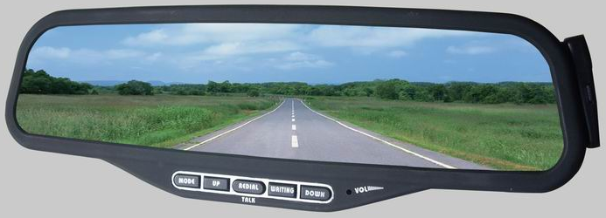
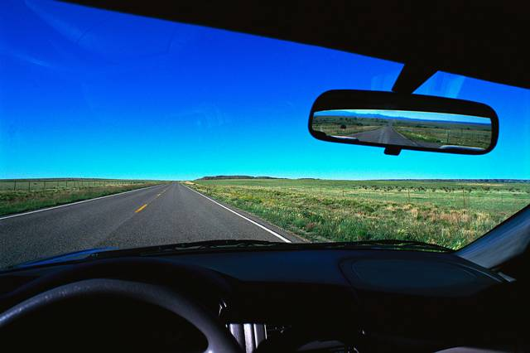
Reactive vs. Proactive methods
Monitoring own recent performance
Monitoring for recurrent contexts
Monitoring performance of peers

Slide 38
Concept Drift Summary
Predictors should anticipate & adapt to changes
  From reactive towards proactive adaptation
Improve usability and trust
  Integrate domain knowledge
  Provide transparency, explanation and control for
    how changes are detected
    how changes are handled, how models are adapted
  Visualization of drift, explanations, business logic
  Semi-automation, i.e. interaction with an expert
A system-oriented perspective is lacking
Notes:
accuracy, safely, stability in variety of settings
Context-awareness may become an answer

Slide 39
Part II: Ethics-aware Predictive Analytics
  Trust, fairness, accountability, & transparency

Slide 40

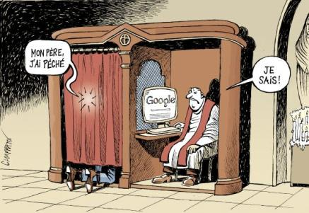
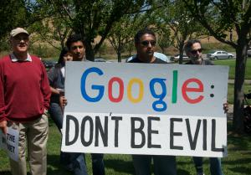
Fear of Privacy Violation & Data Misuse
corpwatch.org/img/original/google.jpg
“Many companies are looking to profit from student and teacher data that can be easily collected, stored, processed, customized, analyzed, and then ultimately resold”.
  Philip McRae (Alberta Teachers’ Association)
Notes:
Privacy policy vs. profiling policy
backlash against mining of student data
http://www.corpwatch.org/article.php?id=15951
http://dyn.politico.com/printstory.cfm?uuid=5262F339-E833-4C1F-A9F7-8A0F20BC2F13

Slide 41
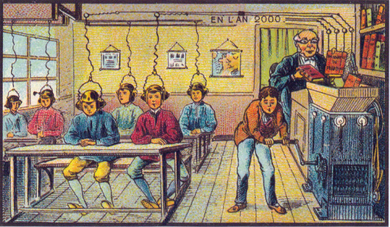

Fears of Personalization
“When Personalization Goes Bad”
  http://www.portical.org/blog/when-personalization-goes-bad
“Rebirth of the Teaching Machine through the Seduction of Data Analytics: This Time It's Personal”
  http://www.philmcrae.com/2/post/2013/04/rebirth-of-the-teaching-maching-through-the-seduction-of-data-analytics-this-time-its-personal1.html
“This time it is Personal and Dangerous”
  http://barbarabray.net/2013/12/30/this-time-its-personal-and-dangerous/
Postcard (World’s Fair, Paris 1899) predicting what learning will be like in France in the year 2000
©
Pawel Kuczynski
Notes:
postcard from the World’s Fair in Paris, Circa 1899 predicting what learning will be like in France in the year 2000
http://commons.wikimedia.org/wiki/Category:France_in_XXI_Century_(fiction)
“Data is all I need”

Slide 42
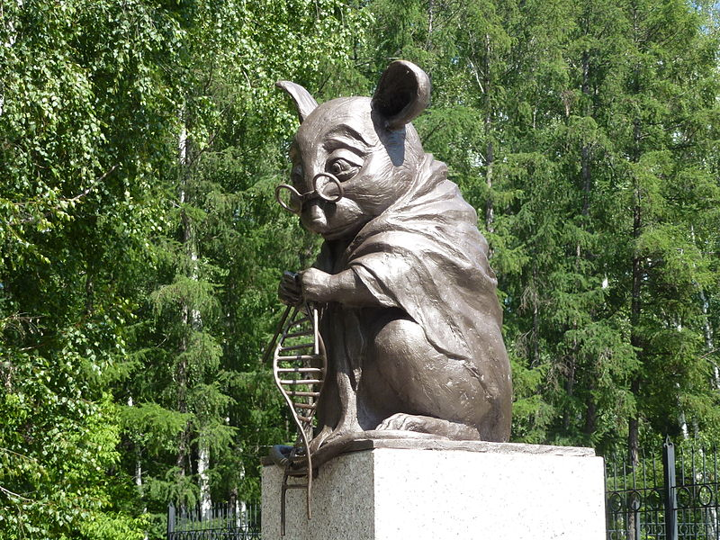
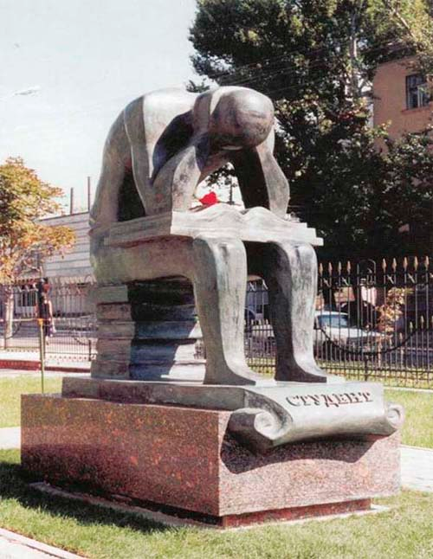
Existing Monuments
Monument to lab mice,
Institute of Cytology and Genetics in Novosibirsk
http://memorysensory.com/
monument-to-the-student-in-saratov/
Related fears about data-driven education

Slide 43
2014 Whitehouse Review of Big Data
Big Data: Seizing Opportunities, Preserving Values report:
“big data technologies can cause societal harms beyond damages to privacy”
decisions informed by big data could
  have discriminatory effects, even in the absence of discriminatory intent, and
  further subject already disadvantaged groups to less favorable treatment.
threats of opaque decision-making
called for studying the dangers of “encoding discrimination in automated decisions” and methods to address them
Notes:
конфиденциальность

Slide 44
“Helping” Domain Experts
Police – screening suspects in airports
Judges – deciding on pre-trial period of suspects
eCommerce – cookie-based price adjustments
Education – giving a negative study advice
Mortgages, car insurances, jobs, salaries, …
Food for thought:
Discrimination – inferior treatment based on ascribed group rather than individual merits
Predictive analytics as means of gaining insights
into human evaluations
Notes:
How are they wrong, how are the biased
(Personalized) Medicine

Slide 45
Why Can Predictive Models Can Discriminate?
Labels are wrong <= historically biased decisions
  stereotypes wrt race, ethnicity, gender, age
  economic incentives
Data is incomplete => omitted variable bias
  leaving out important causal factor(s)
  the model compensates for the missing factor by over- or underestimating the effect of other factor(s).
Sampling bias
Note:
we assume there is no intent to discriminate
Notes:
the assumed specification is incorrect in that it omits an independent variable that is correlated with both the dependent variable and one or more included independent variables.

Slide 46
Predicting with Sensitive Attributes
population
(source)
Training:
y = L (X, S)
Application:
use L
for new data
y' = L (X’,S’)
enforcing
P(Y=1|X,S=‘male’) = P(Y=1|X,S=‘female’)
X'
Testing
data
Sensitive
labels
2. application
Historical
data
Model L
X
1. training
S
Sensitive
y
labels
action?
a’ = argmax(p(y’=1))

Slide 47
Discrimination-aware Solutions
Remove sensitive attributes?

Slide 48
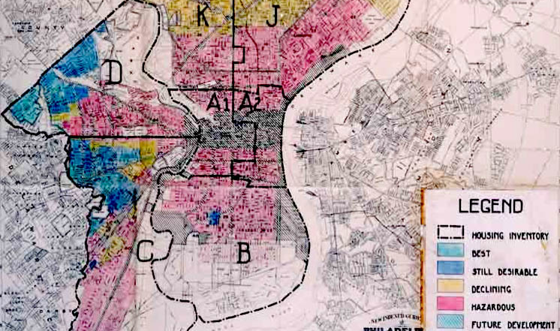
Redlining
Source: "Home Owners' Loan Corporation Philadelphia redlining map”, Wikipedia

Slide 49
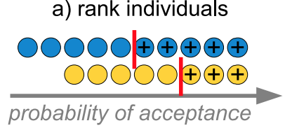
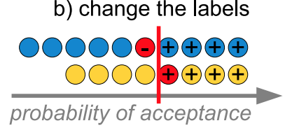
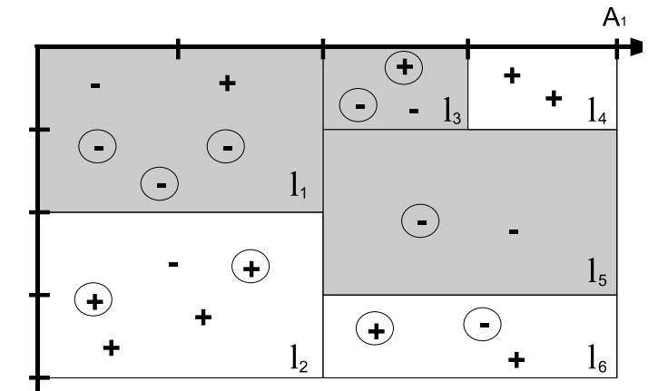
Discrimination-aware Solutions
Remove sensitive attributes?
Preprocessing – “data massaging”
  Modify input data
  Resample input data
Constraint learning
  Algorithm-specific, e.g. decision trees
Postprocessing
  Modify models
  Modify outputs

Slide 50
Predicting with Sensitive Attributes
Paradox: we need to use personal data to control for unethical predictive analytics
“Fairness through awareness” Dwork et al.
“It’s Not Privacy, and it’s Not Fair” Dwork & Mulligan
“Discrimination and Privacy in the Information Society” Custers et al. (Eds)
  Data mining for discrimination discovery
  Explainable/conditional vs. unethical discrimination
  Accuracy-discrimination tradeoff
Notes:
In order to treat similar individuals similarly we must collect more data about individuals. Connections between privacy-preserving and fair predictive modeling. (Cynthia Dwork)
https://myweps.com/moodle/course/view.php?id=286#section-1
http://www.cs.ucdavis.edu/wp-content/uploads/2014/10/FA14-Cynthia-Dwork-CS-logo-22.jpg?d96c63
http://www.cs.toronto.edu/~zemel/documents/fairAwareItcs2012.pdf
http://www.springer.com/engineering/computational+intelligence+and+complexity/book/978-3-642-30486-6

Slide 51
Summary of Ethics-Awareness
One of the central goals: avoid unfairness
Bi-directional educating computer scientists and policy-makers about ethics, privacy & legal aspects
Educating users vs. explaining predictions
Better understanding of trade-offs
New ecosystems and policies for data collection, use, and preventing data misuse
New ecosystems and policies for user empowerment, i.e. informing and giving control
Notes:
Poor understanding of trade-offs
Privacy-personalization, personalization-discrimination, economic utility – discrimination,

Slide 52
Further Reading
Handling concept drift
Gama et al (2014) “A Survey on Concept Drift Adaptation”. ACM Computing Surveys 46(4)
Žliobaitė et al. (2015), “An overview of concept drift applications,” in Big Data Analysis: New Algorithms for a New Society, Springer
Ethics-aware predictive analytics
http://www.fatml.org/
http://www.nickdiakopoulos.com/
http://www.zliobaite.com/non-discriminatory

Slide 53


Thank you!
Collaboration, proposals:
m.pechenizkiy@tue.nl
Staying connected:
nl.linkedin.com/in/mpechen/

Slide 54
Extra slides
  Insights from case studies
  Food wholesale prediction
  Stress analytics
  VoD
  More on concept drift
  Educational data mining example

Slide 55
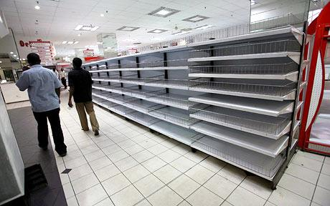
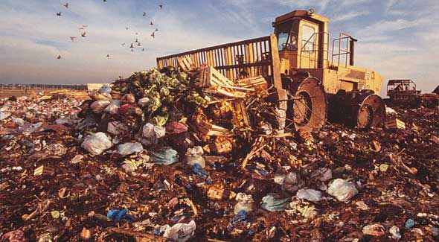
Demand Prediction for Stock Balancing
Prediction
Actual
Empty shelves
vs.
Perishable goods becoming obsolete

Slide 56
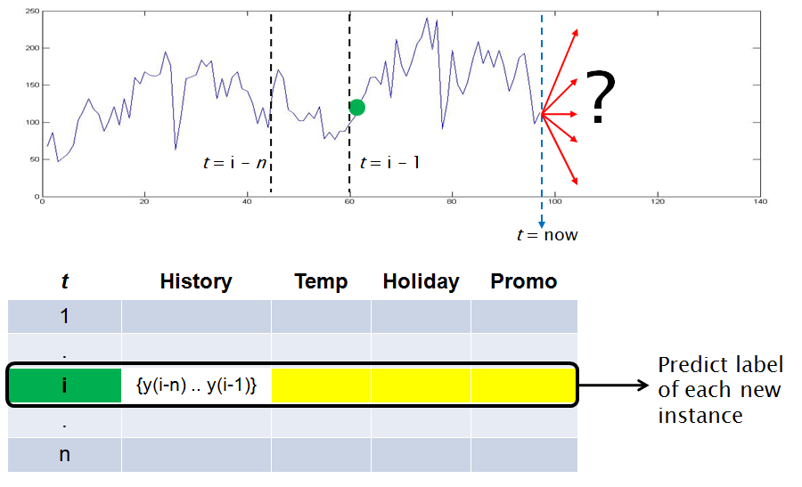
Food Wholesales Prediction

Slide 57
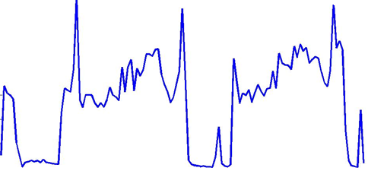
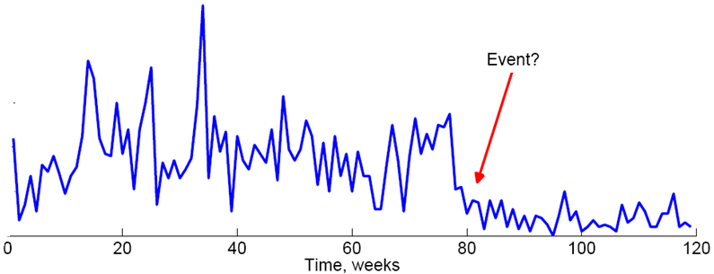
Drifts in Food Wholesales
Reoccurring season

Slide 58
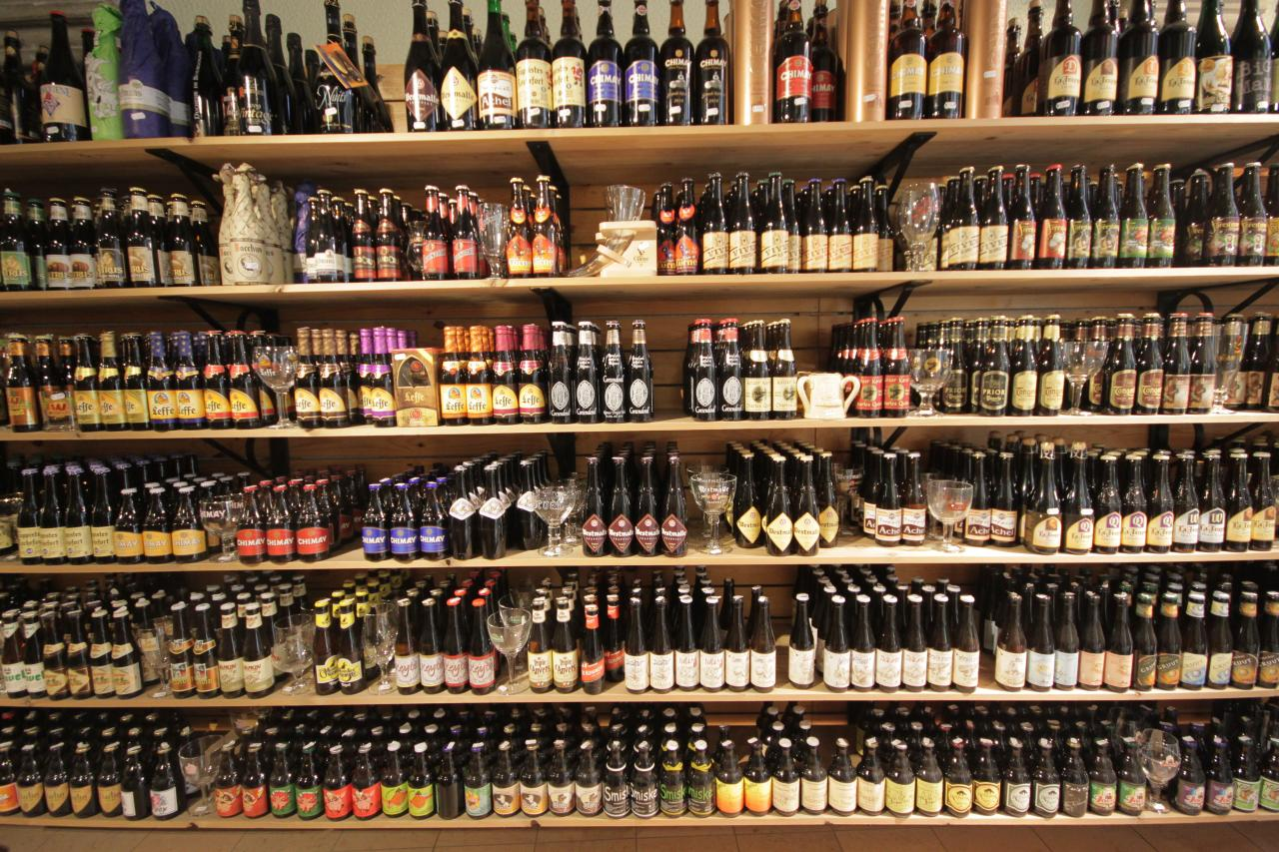
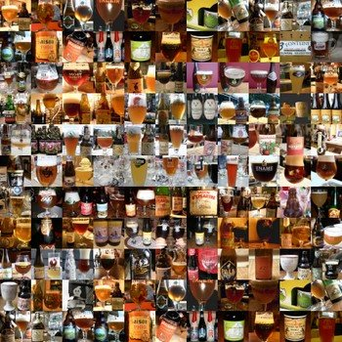
Prediction for Multiple Objects
Identifying related products
Content-based vs. behavioral similarity
Notes:
Changes is demand
In an individual resource adjusting based on observations how other products are behaving
Before moving to Holland I thought that the demand for different kinds of beers would be the same
200+ of Dutch and Belgium beers was an eye opener, summer and fall beer, christmass beer, placing them into the same bukker would be wrong

Slide 59
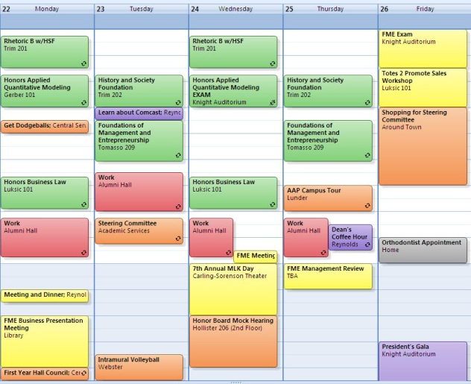



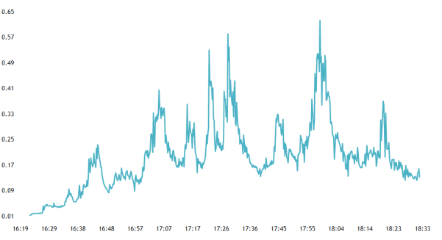
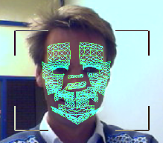
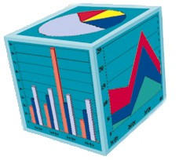
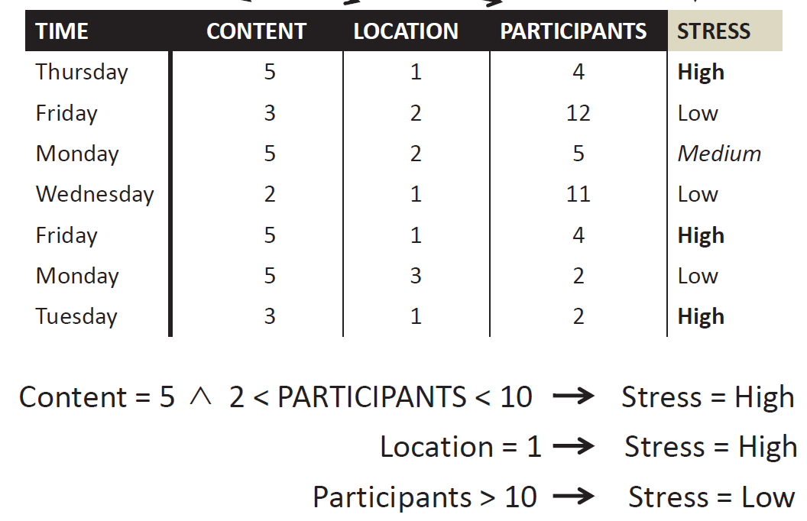
Stress Analytics Framework
What, When, Where,
with Whom
Physiological signs
Pattern Mining
OLAP cube

Slide 60
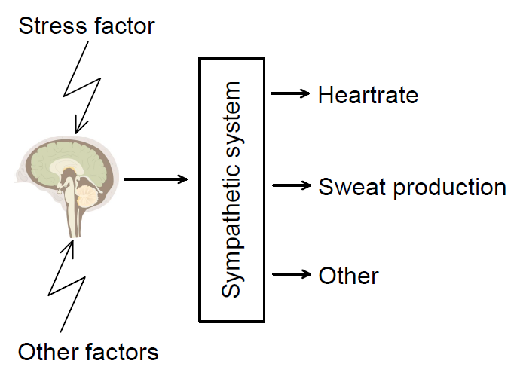
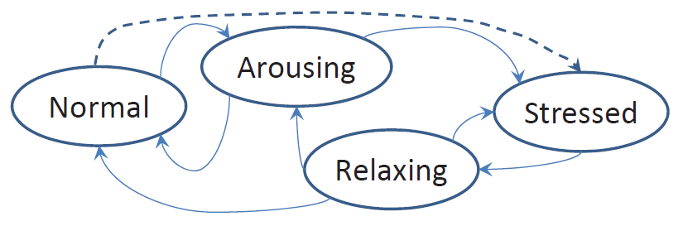
How to Measure Stress
Determine stress level
based on observed
sweat production

Slide 61
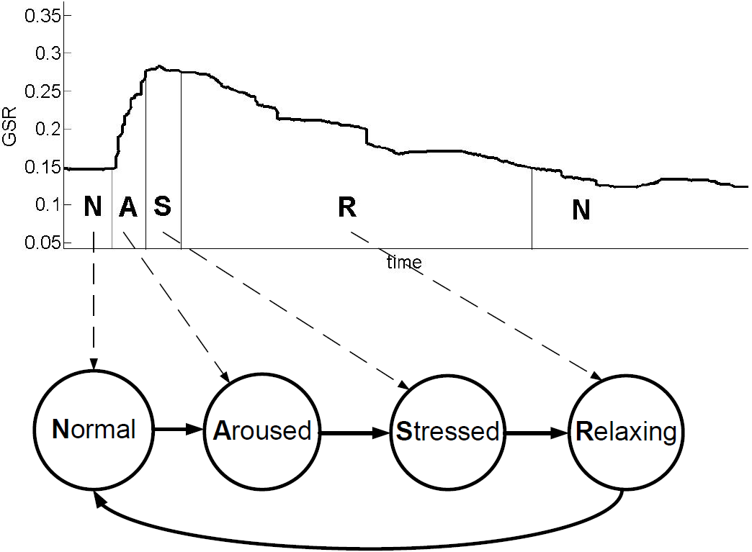
Detection and Categorization of Stress
Based on GSR data alone - not as easy as the following figure may suggest:
Notes:
it is not that easy in online and even offline settings

Slide 62
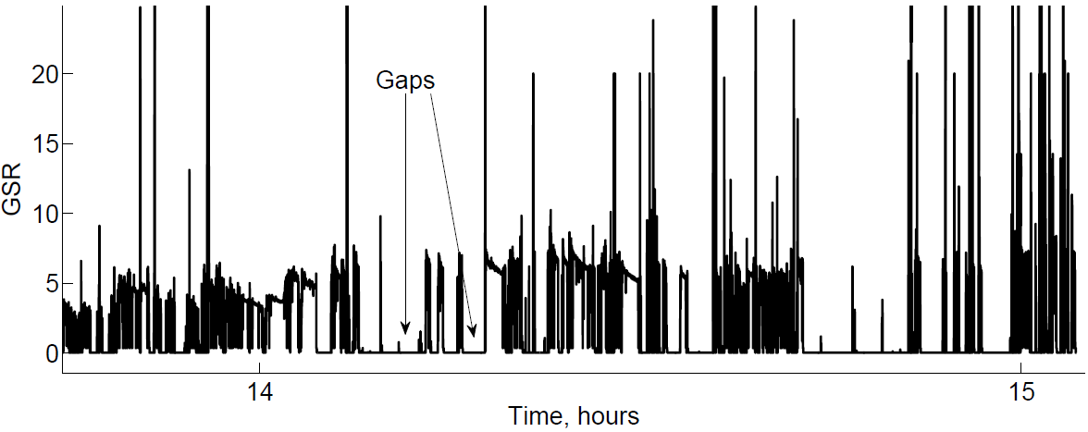
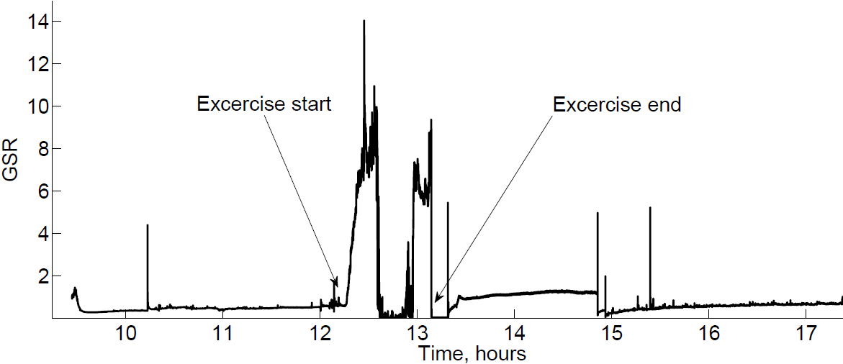
Challenges in Stress Detection
All kinds of noise, e.g. loosing contact with the skin
Activity (exercising) , environment (cold/hot) context and personal differences may impact GSR we observe

Slide 63
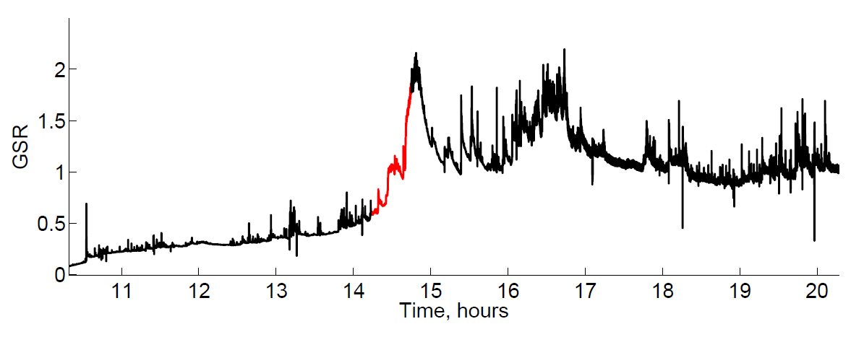
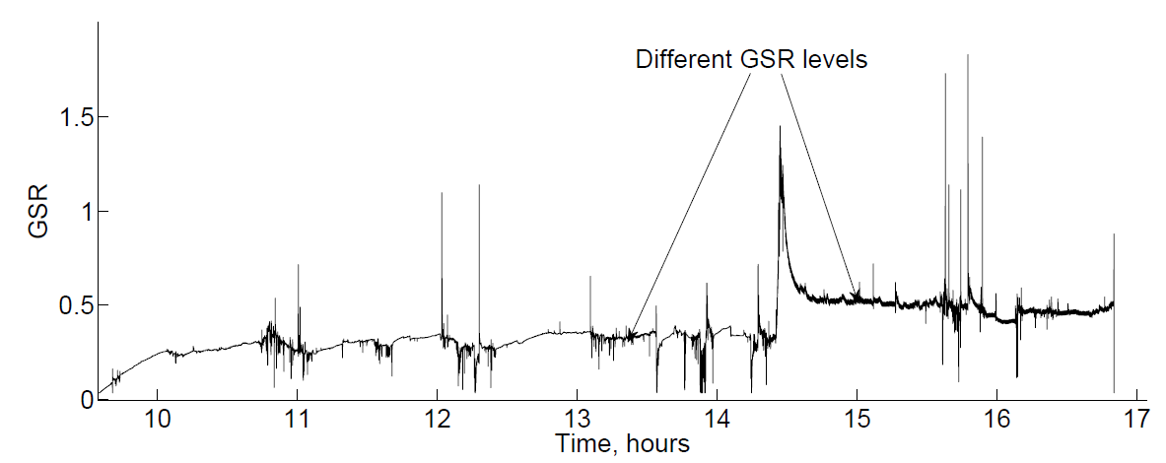
Interpretation isn’t Straightforward

Slide 64
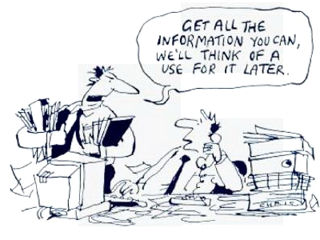
Adding More Data to Disambiguate
Skin and room temperature, noise, accelerometer, voice, face, …

Slide 65

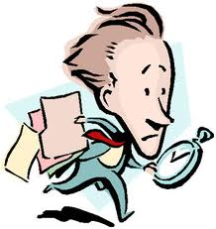

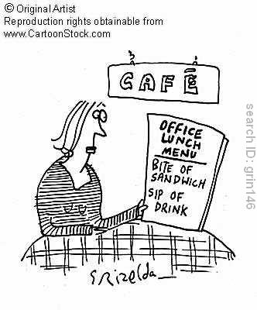

Activity Recognition Can Help
Writing vs. typing vs. walking vs. teaching vs …
Analyzing accelerometer data only? (wrist band)
Notes:
vs. monitoring cameras vs GPS etc
Running from Auditorium to

Slide 66
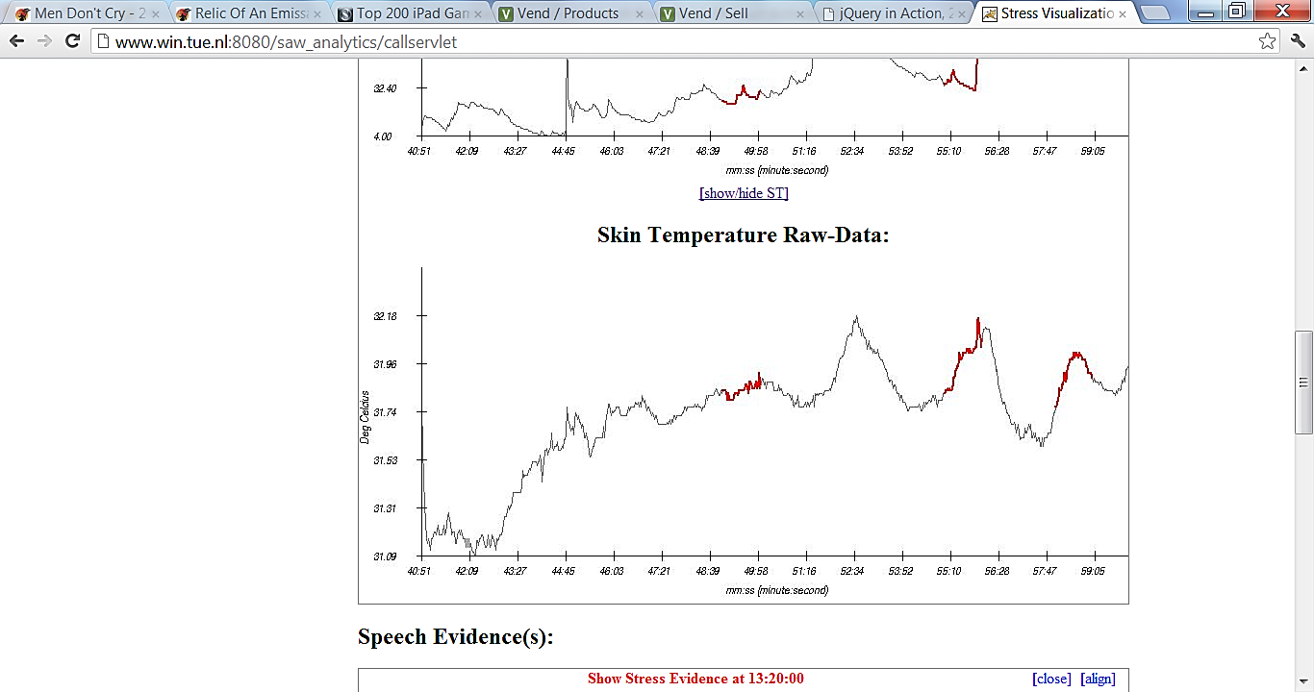
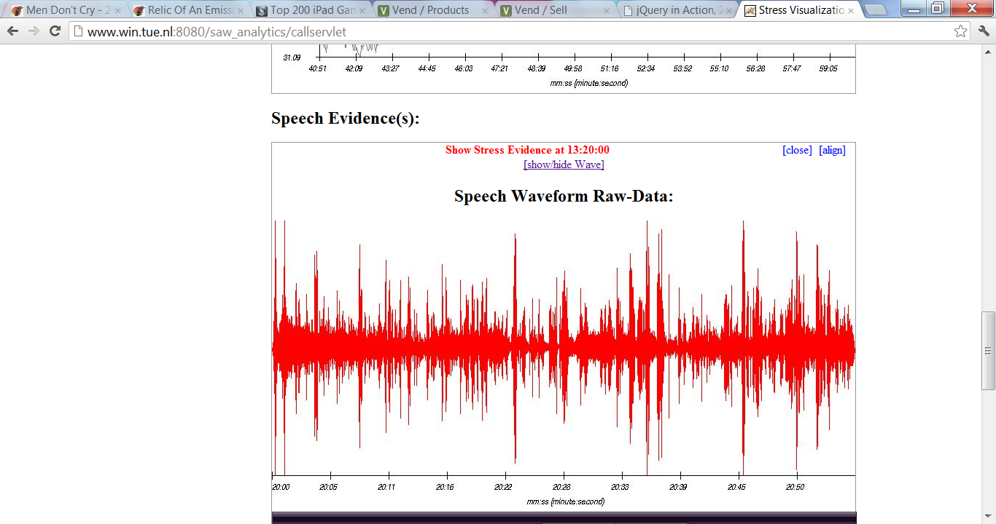
Aligning of Data Sources
60 seconds
GSR
Instance 1
Instance 2
Instance 3
speech
Instance 1
Instance 2
Instance 3

Slide 67


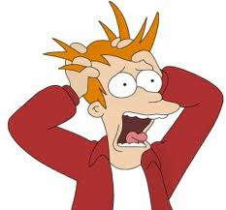

Is Acute Stress Good or Bad?

Slide 68



What is the Relaxation Then?

Slide 69



Is “Normal” Condition Good or Bad?
What if someone’s patterns looks like NNNNNNNNNNNNNNNN ……

Slide 70

Predictive Analytics as a Form of
Data-Intensive Scientific Discovery
http://research.microsoft.com/en-us/collaboration/fourthparadigm/

Slide 71
Learning@Scale Potential
Two central questions in DDE
“Does it work?” and “Which way is better?”
Some emerging research lines:
Gaining insights via (massive) A/B testing
Predictive modeling with actionable attributes
  Prediction vs. persuasion vs. manipulation
Predictive modeling with sensitive attributes
  Ethics-aware personalization w/out discrimination
Notes:
Learning at scale, synergy of R&D
Efficient way to … organize A/B testing
and
then explain the following four key challenges we need to address to
empower EDM and LA with more effective and informative means:
(1) bridging learning sciences educational background knowledge, and EDM and LA together;
(2) discovering actionable knowledge from the
randomized controlled trials, i.e. going beyond the rejection of a
null hypothesis and comparing effectiveness of different strategies;
(3) modeling context and temporal dynamics of learning processes;
(4) understanding, identifying and accounting for biases in the
educational data we use in analytics.

Slide 72

Data Trumps Experts’ Intuition
LAK, AIED & EDM: help in understanding what works and what does not, student modeling etc
MOOC, ITS & L@S:
A/B testing is becoming popular
MOOC platforms provide support for A/B testing
Example by Ken Koedinger (CMU)
at Data-driven education @NIPS2013
Intuitive design can be
replaced by data-driven
Notes:
Discovering better models of what is hard for students to learn
Do educators know what they know?
Datashop learning curve analytics
Open science/open ML initiative to accumulate results of tons of experiments
Recognized need for data-driven explanatory models of learners; Intuitive design is not reliable
A/B testing popularity: like in recsys, IR, computational advertising – relatively cheap and relatively efficient because of a wide-spread and reliable flow

Slide 73
We Are Able to Look Deeper
How these averages could possibly differ per
Student learning style
Student background
Country they studied
Ethnicity
Gender
Parents
….
Notes:
Demographics (gender, race, income, education of parents)
Proxies to demographics (home address or school location)
Some (un)known artifacts of data collection
Different instances of a course
Different instructors
Different groups (locations)
Discovering better models of what is hard for students to learn
Do educators know what they know?
Datashop learning curve analytics
Open science/open ML initiative to accumulate results of tons of experiments
Recognized need for data-driven explanatory models of learners; Intuitive design is not reliable
A/B testing popularity: like in recsys, IR, computational advertising – relatively cheap and relatively efficient because of a wide-spread and reliable flow

Slide 74

Design: (Re-)Learning Classifiers & Context
Notes:
Contextual features – are not necessary predictive, or define the object,

Slide 75

Evolving data: Monitoring for Changes
in Data,
Context &
Predictions

Slide 76


User Navigation Graph

Slide 77

Motivation for Contextual Markov Models
Useful Contexts: local models do a better job
E[M] < pc1*E[Mc1] + pc2*E[Mc2]
Why should it help?
Explicit contexts (user location)
Implicit contexts (inferred from clickstream)

Slide 78

Implicit Context
C = user type
c1 =
Novice users
c1 = Experienced users
Discover clusters in the graph using community detection algorithm

Slide 79
Change of Intent as Context Switch
Context “Find information”
Context “Buy product”
Search
Refine Search
Click
Product View
Payment
Search
Click
What is next?
Change of intent?
Timeline

Slide 80

Prediction under Concept Drift
Antibiotic Resistance Prediction:
predict the sensitivity of a pathogen to an antibiotic based on data about the antibiotic, the isolated pathogen, and the demographic and clinical features of the patient.
Notes:
Changes in the population of people vs. changes in the population of pathogens (more and more develop resistance)
(Tsymbal et al., 08)

Slide 81



How Antibiotic Resistance Happens
Notes:
Antibiotic resistance results from gene action. Bacteria acquire genes conferring resistance in any of three ways.
Different ways how resistance may happen
Different ways how resistance may spread
Physical connections/hospital organization
Local drift
Solution:
Contextual approach at the instance level
Dynamic integration of classifiers

Slide 82

Peer-to-peer Handling of Drift
the first peers to ‘suffer’ can share their knowledge with other peers in a controlled manner
(temporal) association exists between peers p1 and p2
Notes:
adapting to changes would be more effective if the first peers to ‘suffer’ can share their knowledge with other peers in a controlled manner

Slide 83
Reoccurring drifts
From reactive to proactive handling of drift
Model recurrence and periodicity
Recognize & reuse situations from the past
  Learn from the external data
  Multi-sensor environments;
  Context-awareness
  Learning from multiple objects case
  Learn in the distributed environments
Notes:
Reactive – assume that it may happen, monitor for it and get ready to refine the model

Slide 84
Handling Concept Drift
change source
adversary
interests
population
complexity
expectations about changes
unpredictable
predictable
identifiable
labels
real time
on demand
fixed lag
delay
decision speed
real time
analytical
ground truth labels
soft/hard
costs of mistakes balanced/ unbalanced
expectations about desired action
keep the model uptodate
detect the change
identify/locate the change
explain the change
Notes:
What do we need to do about it – update model – or detect the change, or also locate it and explain it,

Slide 85
Research vs. Practice
If it were user modeling for adaptive news access
 | Research | Practice
Change type | Sudden | Sudden, gradual/incremental, recurring Multiple types in the same application
Change expectation | Unpredictable, unexpected | Unpredictable, expected, predictable
Labels | Immediately available | Proxies for labels available, with some fixed/variable delay, never
Ground truth | Objective | Objective, subjective
Background knowledge | Not available | Available, not available
Evaluation | Simulation/log replay | Deployment and live traffic needed
Reoccurrence | Independent of each other, unexpected | Expected, predictable, explainable
Drifts in multiple objects | Independent of other objects | Affected by, predictable from other objects
Notes:
Research:
Change is unpredictable, typically sudden
True labels are available right after casting predictions for verification/relevance feedback
Only one type of change and for a particular reason is anticipated/monitored for
Only one object corresponds to a concept
No closed loop control
No bias due to adaptation
We can replay the history, multiple times if needed to fine-tune the parameters
Reality:
Changes may (re-)occur multiple times
during the analytics lifetime of an object
across multiple objects with related behavior
need to monitor for different kinds of changes
Multi-sensory environment/data,
each somewhat unreliable
but allowing to collaboratively manifest CD
Labels are not (immediately) available
Labels ≠ Ground truth
Background knowledge about the process/ changes may be available
Need to deploy to evaluate/finetune properly

Slide 86
How Can We Explain Change?
Do change detection as well as a (rule-based) early classification for the same problem
Linking detected changes to context
Multi-modal affective data example
  Stress analytics

